Slide 1
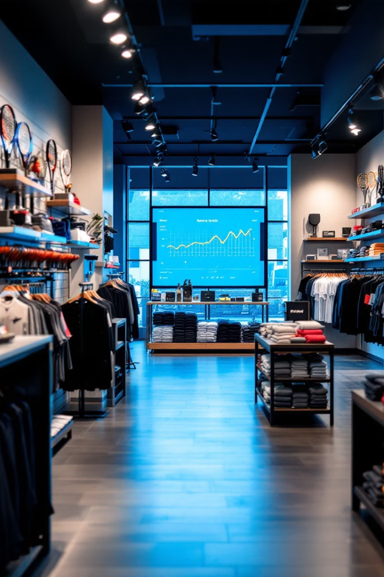
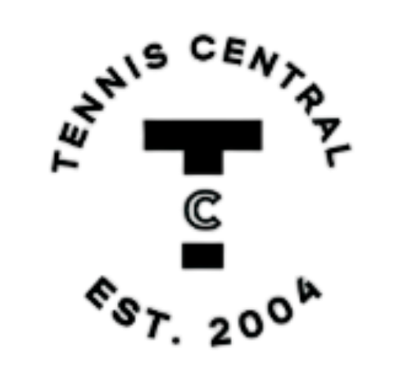

Tennis Central: Data-Driven Store Expansion
Team Tennis Central analyzed sales data to support Tennis Central's expansion, creating a Power BI dashboard for inventory, staffing, and promotions. Key team members included.
Group Members
Ayushi Arora
Mansi Maniar
Rushil Parikh
Shyamal Bhatt
Varun Kumar

Slide 2
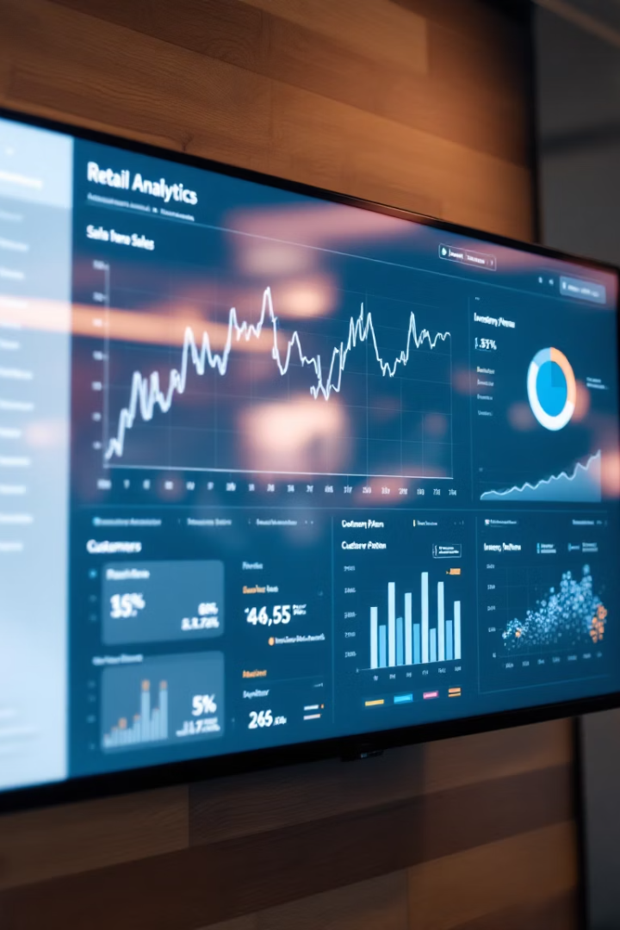




Business Problem & Analytics Questions
Inventory Planning
Identifying top-selling products and forecasting demand to ensure optimal stock levels, minimizing shortages and reducing excess inventory.
Pricing Strategies
Analyzing sales data to develop competitive and profitable pricing models that maximize revenue.
Promotional Planning
Understanding customer buying patterns to design targeted and effective promotions that drive sales.
Operational Efficiency
Optimizing staffing schedules and store layout based on sales trends and customer traffic patterns.

Slide 3
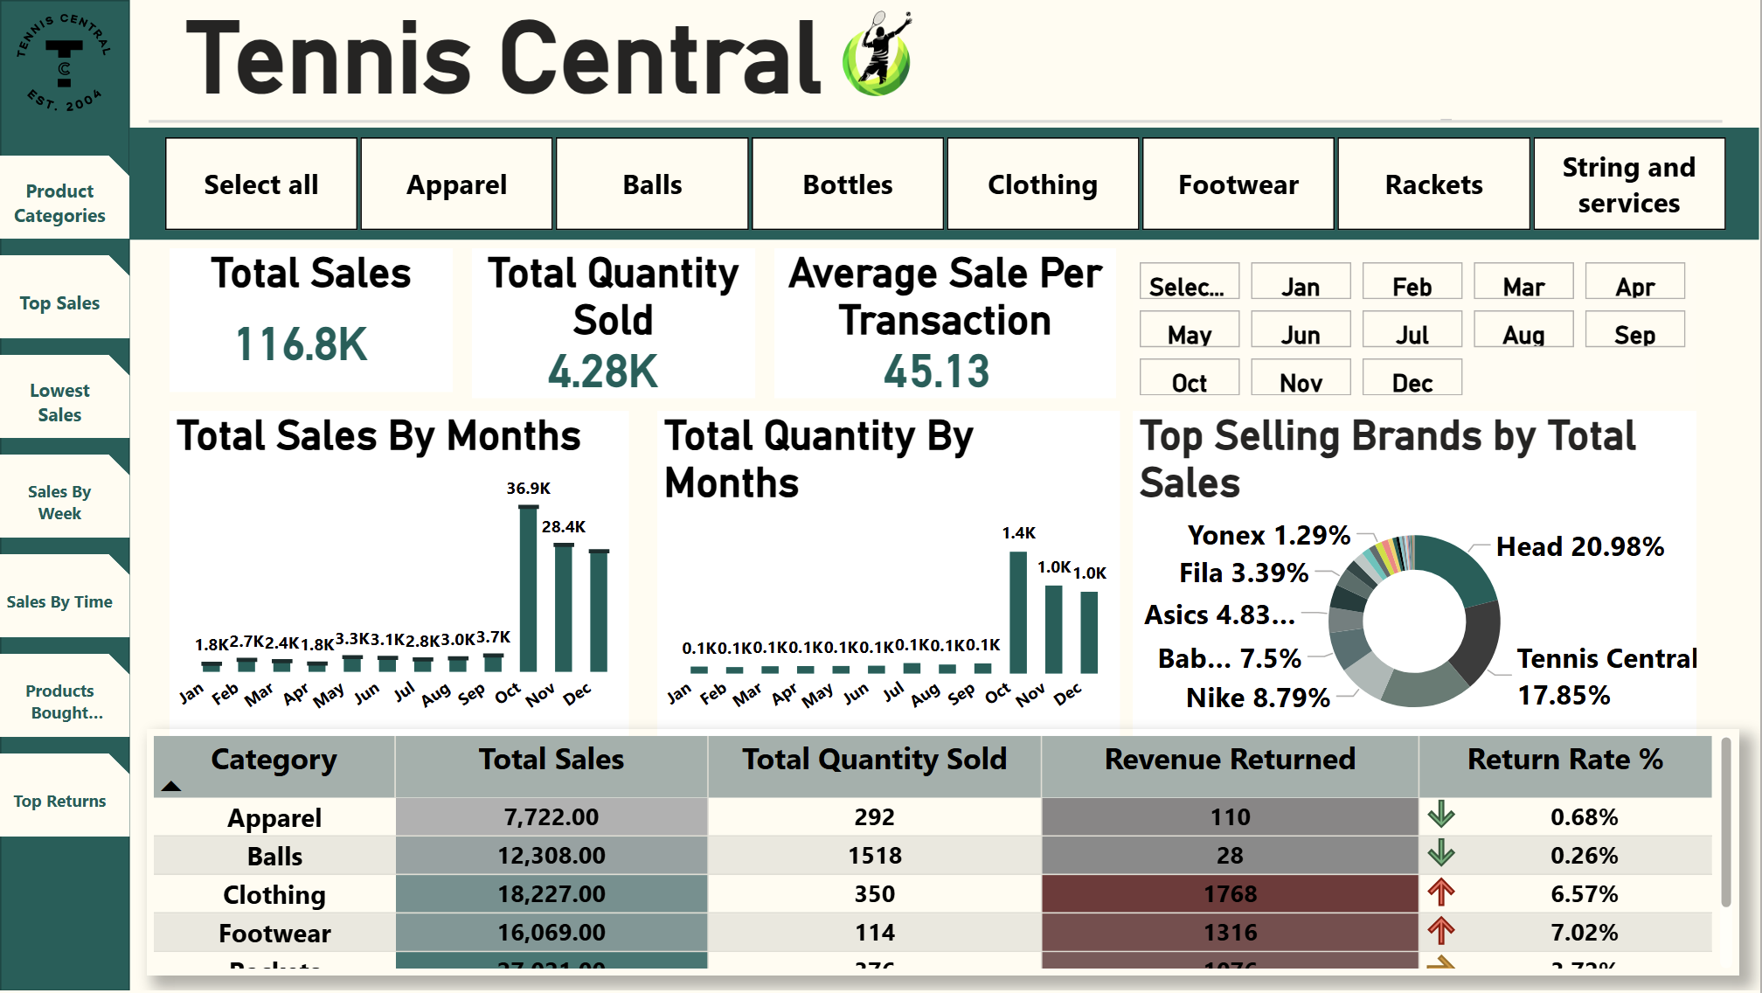
Homepage:

Slide 4


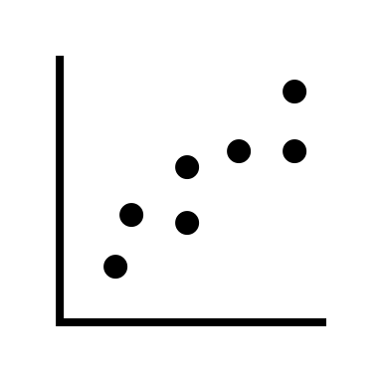
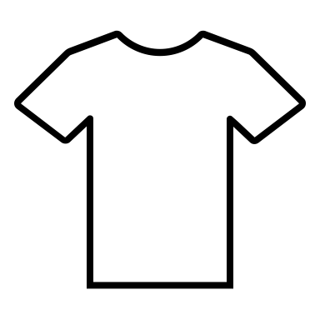
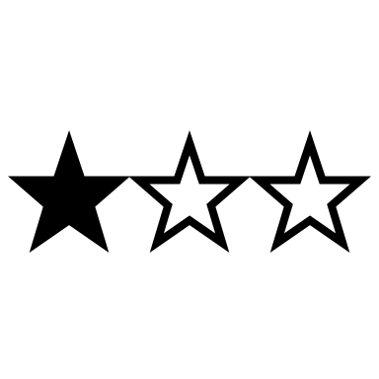
Key Insights: Homepage
Total Sales Overview:
Achieved total sales of 116.8K from 4,280 units, highlighting strong overall market performance.
The average sale per transaction stands at $45.13, indicating solid consumer purchasing power.
Monthly Sales Patterns:
Significant peak observed in October (36.9K) and November (28.4K), indicating seasonal demand increases.
Sales momentum continues through December, highlighting a sustained end-of-year shopping trend
Top Performing Categories:
Clothing and Footwear generated highest revenue, suggesting consumer preference towards apparel.
High total quantities sold in Balls (1,518 units), reflecting frequent purchase behavior due to regular usage and replacements.
Brand Performance:
Head (20.98%) and Tennis Central (17.85%) emerge as dominant brands, critical for inventory planning and targeted marketing.
Notable market share held by other brands such as Nike (8.79%) and Babolat (7.5%), indicating diversified customer preferences.
Return Rate Analysis:
Higher return rates for Clothing (6.57%) and Footwear (7.02%), emphasizing a need to address quality control or sizing/fit issues to enhance customer satisfaction.

Slide 5
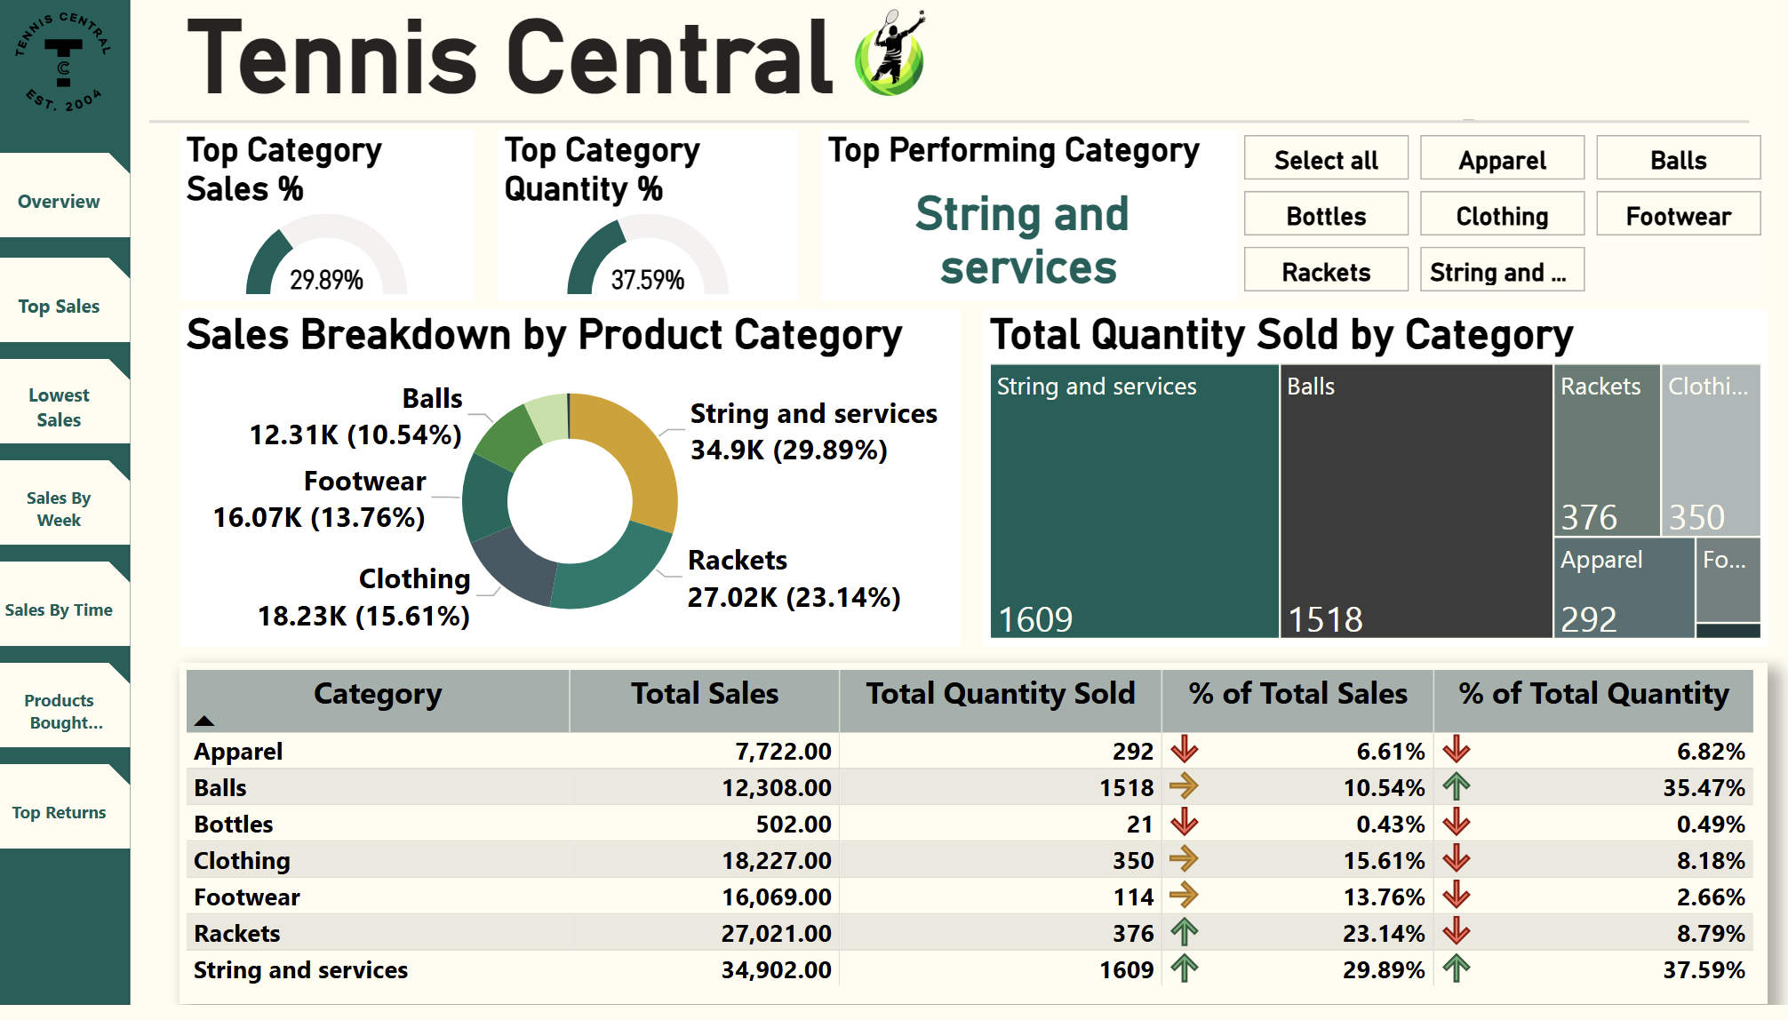
Product Categories:

Slide 6
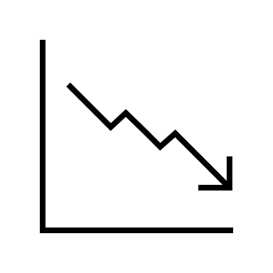
Key Insights: Product Categories
Top Category – String and Services:
Leads with 29.89% of total sales and 37.59% of total quantity sold, indicating high demand for essential tennis services such as racket stringing and maintenance.
Strong Sales in Rackets:
Contributes significantly (23.14%) to total sales, indicating consistent customer investment in essential tennis equipment.
High Volume but Lower Revenue:
Balls show a high sales volume (35.47% of total quantity), yet lower revenue share (10.54%), reflecting frequent low-cost, high-volume purchasing behaviors.
Apparel and Footwear Performance:
Clothing (15.61% of total sales) and Footwear (13.76% of total sales) represent steady consumer interest, presenting opportunities for targeted promotions and upselling strategies.
Areas for Review and Optimization:
Lower performance observed in Bottles (0.43% of total sales) suggests potential reconsideration of product selection or marketing strategies.

Slide 7
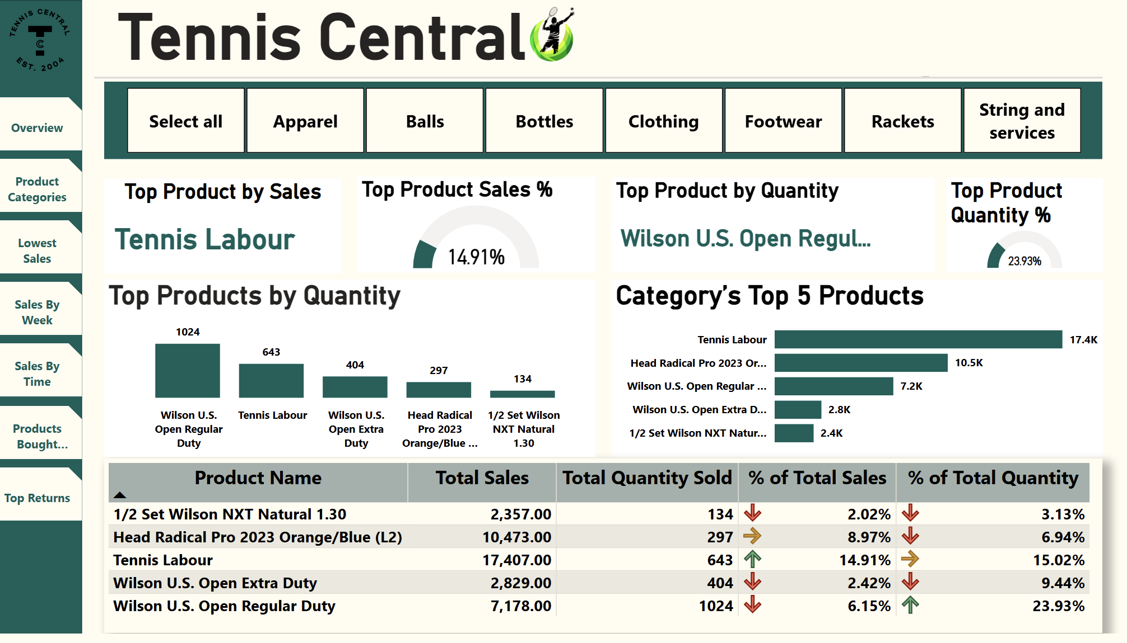
Top Sales:

Slide 8
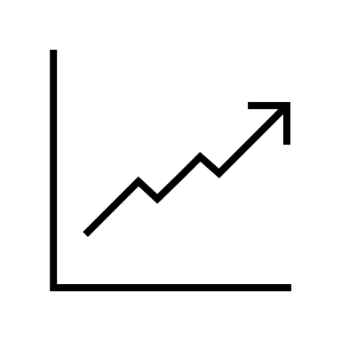


Key Insights: Top Sales
Top Revenue Product – Tennis Labour:
Generates the highest sales revenue ($17.4K, 14.91% of total), emphasizing the strategic importance of offering specialized services.
Highest Quantity Sold – Wilson U.S. Open Regular Duty Balls:
Leads significantly in units sold (1,024 units, 23.93%), reflecting strong customer demand and frequent replenishment needs.
High-Value Equipment Sales – Head Radical Pro 2023 (Racket):
Achieves substantial sales ($10.5K, 8.97% of total revenue) with relatively fewer units (297 units), highlighting customer willingness to invest in premium products.
Strong Performance by Wilson Ball Variants:
Both Regular Duty (6.15% of total sales) and Extra Duty (2.42%) balls indicate consistent consumer preference, valuable for targeted inventory stocking.
Specialized Product Demand – Wilson NXT Natural Strings:
Although lower in total sales (2.02%), this specialized item shows consistent purchasing (134 units), underscoring niche market opportunities within accessories.

Slide 9
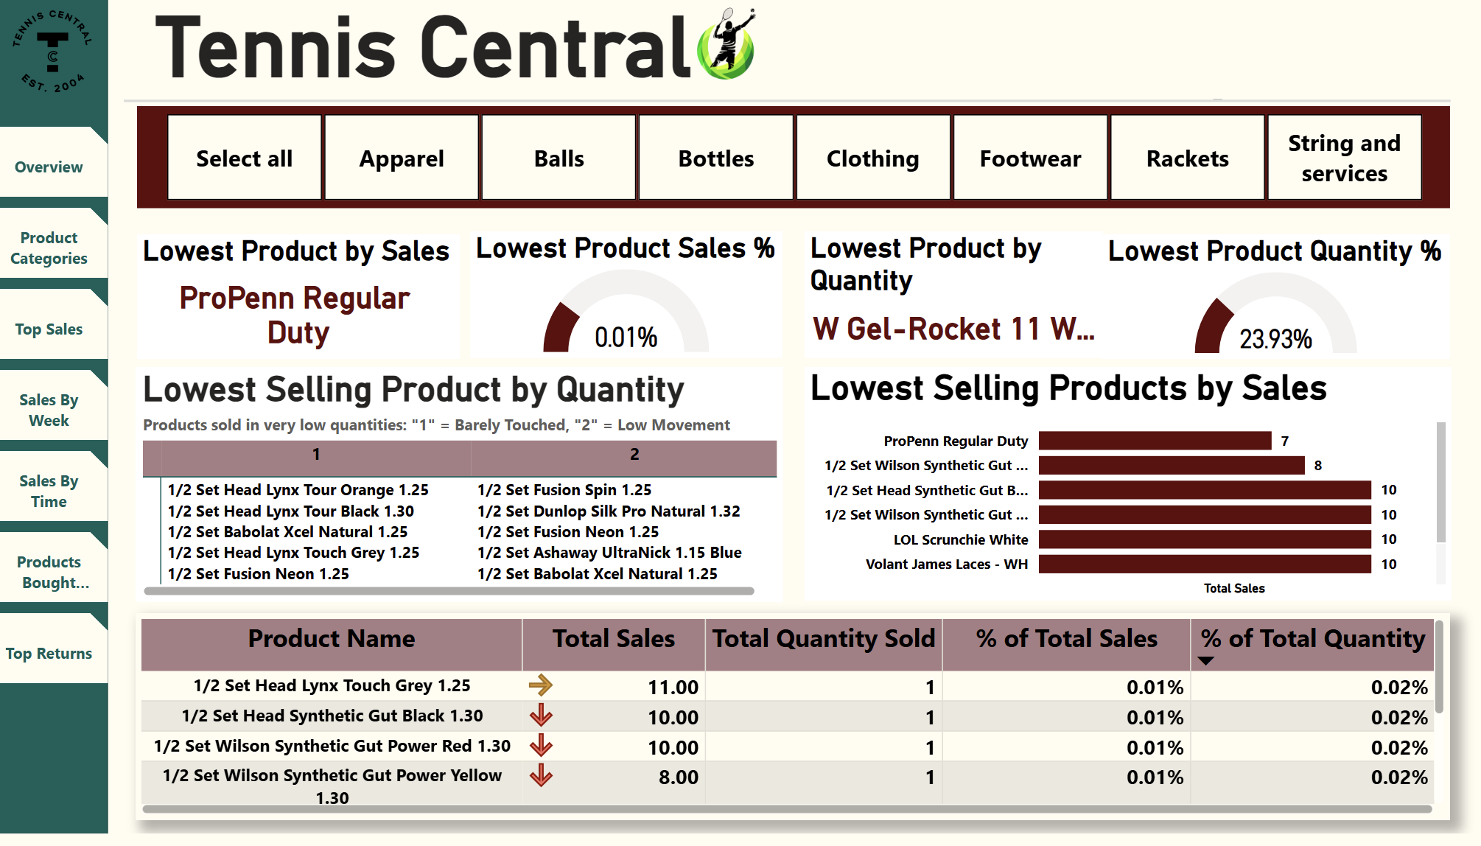
Lowest Sales:

Slide 10


Key Insights: Lowest Sales
Lowest Revenue Product – ProPenn Regular Duty:
Contributes minimally ($7 total sales, 0.01%), indicating very limited customer interest or awareness, suggesting potential removal from inventory.
Minimal Sales Quantity – W Gel-Rocket 11:
Recorded the lowest quantity sold (23.93% of lowest product quantities), highlighting the need to evaluate demand and market strategy for this product.
Extremely Low Movement Products:
Several specialty string products such as Head Lynx, Fusion Spin, and Dunlop Silk Pro each sold only 1-2 units, reflecting niche interest and possibly limited market appeal.
Underperforming Accessories:
Accessory items like LOL Scrunchie White and Volant James Laces barely sold (1 unit each), suggesting limited customer demand or inadequate product visibility.
Inventory Optimization Opportunity:
Persistently low-performing products suggest opportunities to optimize inventory by discontinuing or reducing stock levels, reallocating shelf space to higher-performing categories.

Slide 11
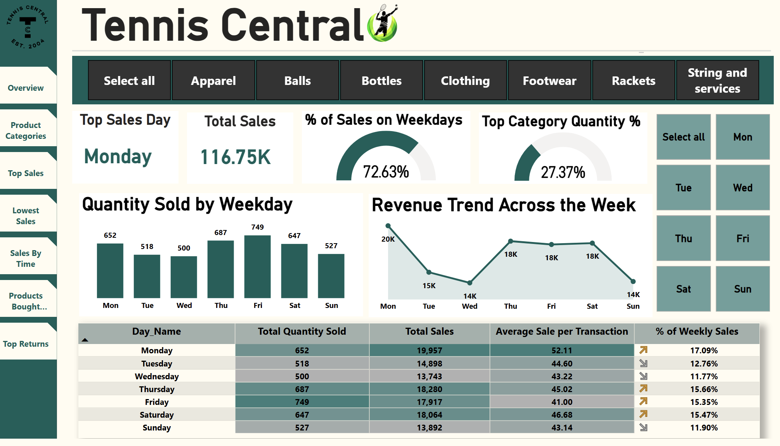
Sales By Week:

Slide 12


Key Insights: Sales By Week
Top Performing Day – Monday:
Monday recorded the highest revenue ($19,957) and strong quantity sold (652 units), making it the most profitable weekday with the highest average sale per transaction ($52.11).
Weekdays Drive Sales Volume:
72.63% of total sales occur during weekdays, highlighting their critical importance for staffing, inventory planning, and promotions.
Friday Leads in Quantity Sold:
749 units sold, the highest among all days, suggesting high customer footfall or online traffic toward the weekend.
Consistent Revenue Mid-to-Late Week:
Revenue remains stable on Thursday to Saturday (approx. $18K daily), indicating continuous mid-week engagement that can be leveraged for targeted offers.
Sunday and Wednesday are the Weakest:
These days show the lowest performance in both sales revenue and quantity sold (e.g., Sunday – $13,892, Wednesday – $13,743), signaling opportunities to introduce campaigns or bundles to improve performance.

Slide 13
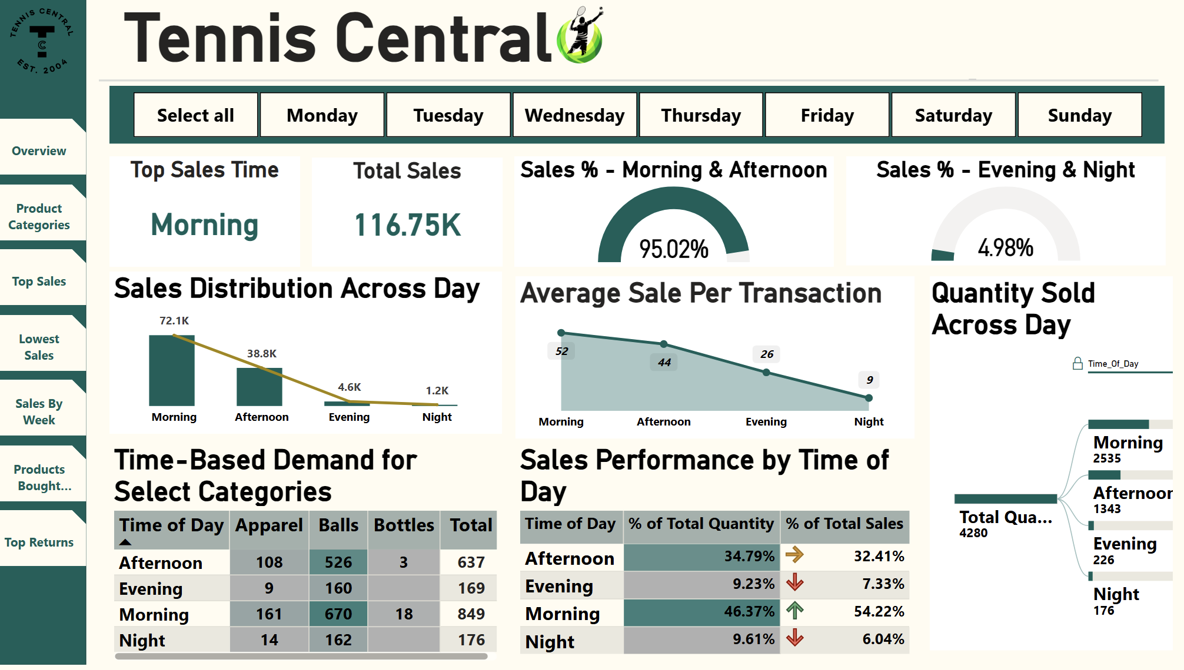
Sales By Time:

Slide 14


Key Insights: Sales By Time
Morning is the Peak Sales Window:
The morning period accounts for 54.22% of total sales and 46.37% of total quantity, making it the most lucrative time slot with the highest average sale per transaction ($52).
95% of Sales Occur Before Evening:
Combined morning and afternoon sales contribute 95.02% of total revenue, emphasizing the importance of front-loading staffing and promotional efforts.
Afternoon Shows Strong Quantity but Lower Spend:
Although 34.79% of items are sold in the afternoon, the average transaction drops to $44, suggesting higher volume but smaller basket size.
Evening and Night Sales Are Minimal:
Only 4.98% of total sales occur during evening and night combined, with significantly lower average transaction values ($26 and $9 respectively), indicating low activity during late hours.
Time-Based Product Demand Varies:
Balls sell consistently throughout the day, while Apparel performs strongest in the morning, supporting time-specific inventory display and marketing strategies.

Slide 15
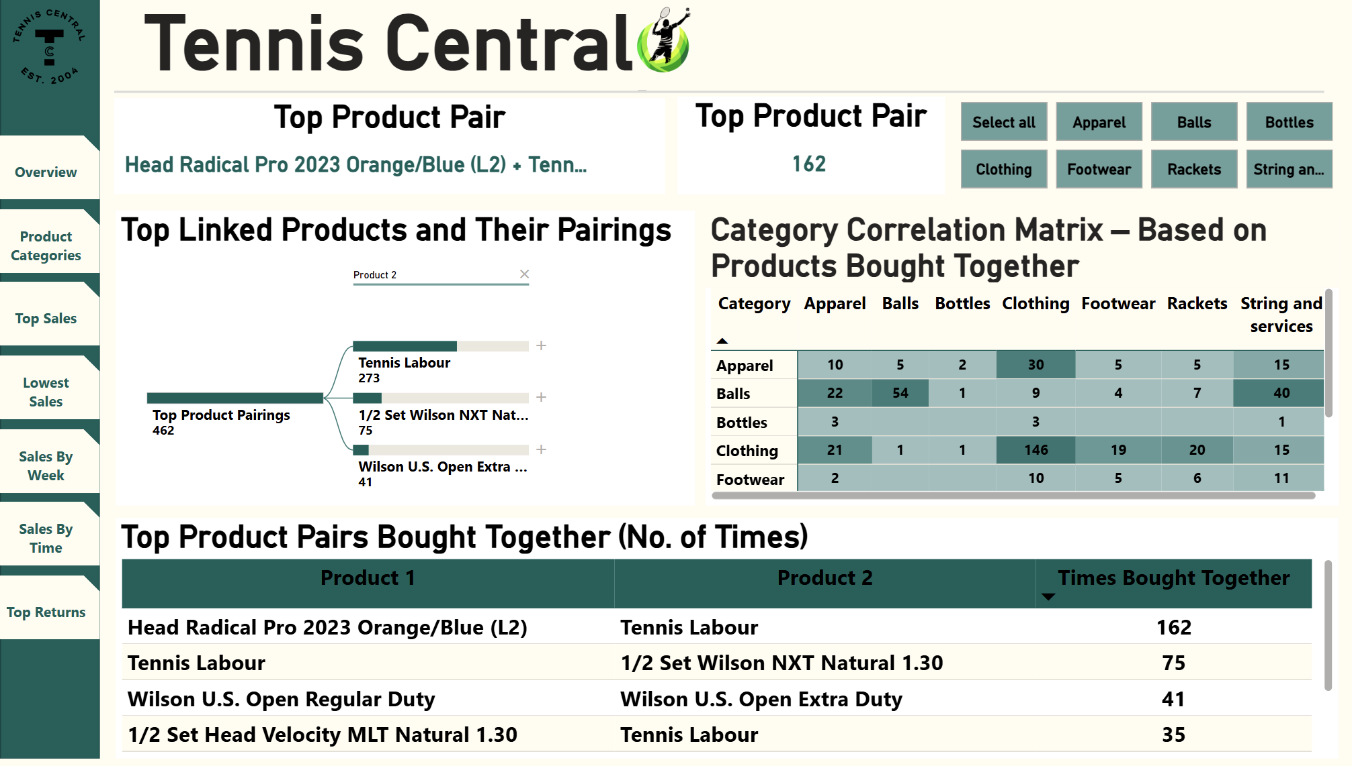
Product Bought Together:

Slide 16

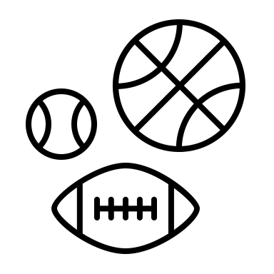
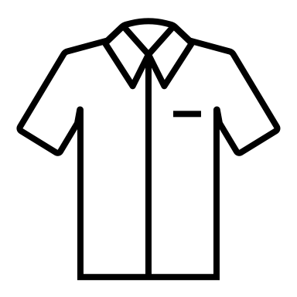
Key Insights: Products Bought Together
Top Product Pair – Head Radical Pro 2023 + Tennis Labour:
Most frequently purchased combo (162 times), indicating customers prefer to pair new rackets with professional stringing services.
Service and Accessory Bundling – Tennis Labour + Wilson NXT Strings:
75 instances of customers purchasing Tennis Labour with Wilson NXT Natural 1.30, highlighting demand for convenience-driven bundled services.
Ball Pairing Consistency – Wilson U.S. Open Variants:
Wilson U.S. Open Regular and Extra Duty balls were bought together 41 times, suggesting brand loyalty and preference for variety in use cases.
Category Correlation – Balls & Stringing Services Strongly Linked:
The correlation matrix shows Balls are frequently bought with String and Services (40 times) and Apparel (22 times), indicating high cross-sell potential.
Clothing Shows Highest Intra-Category Pairing (146 times):
Customers tend to buy multiple clothing items together, supporting strategies like combo discounts or “Buy More Save More” offers.

Slide 17
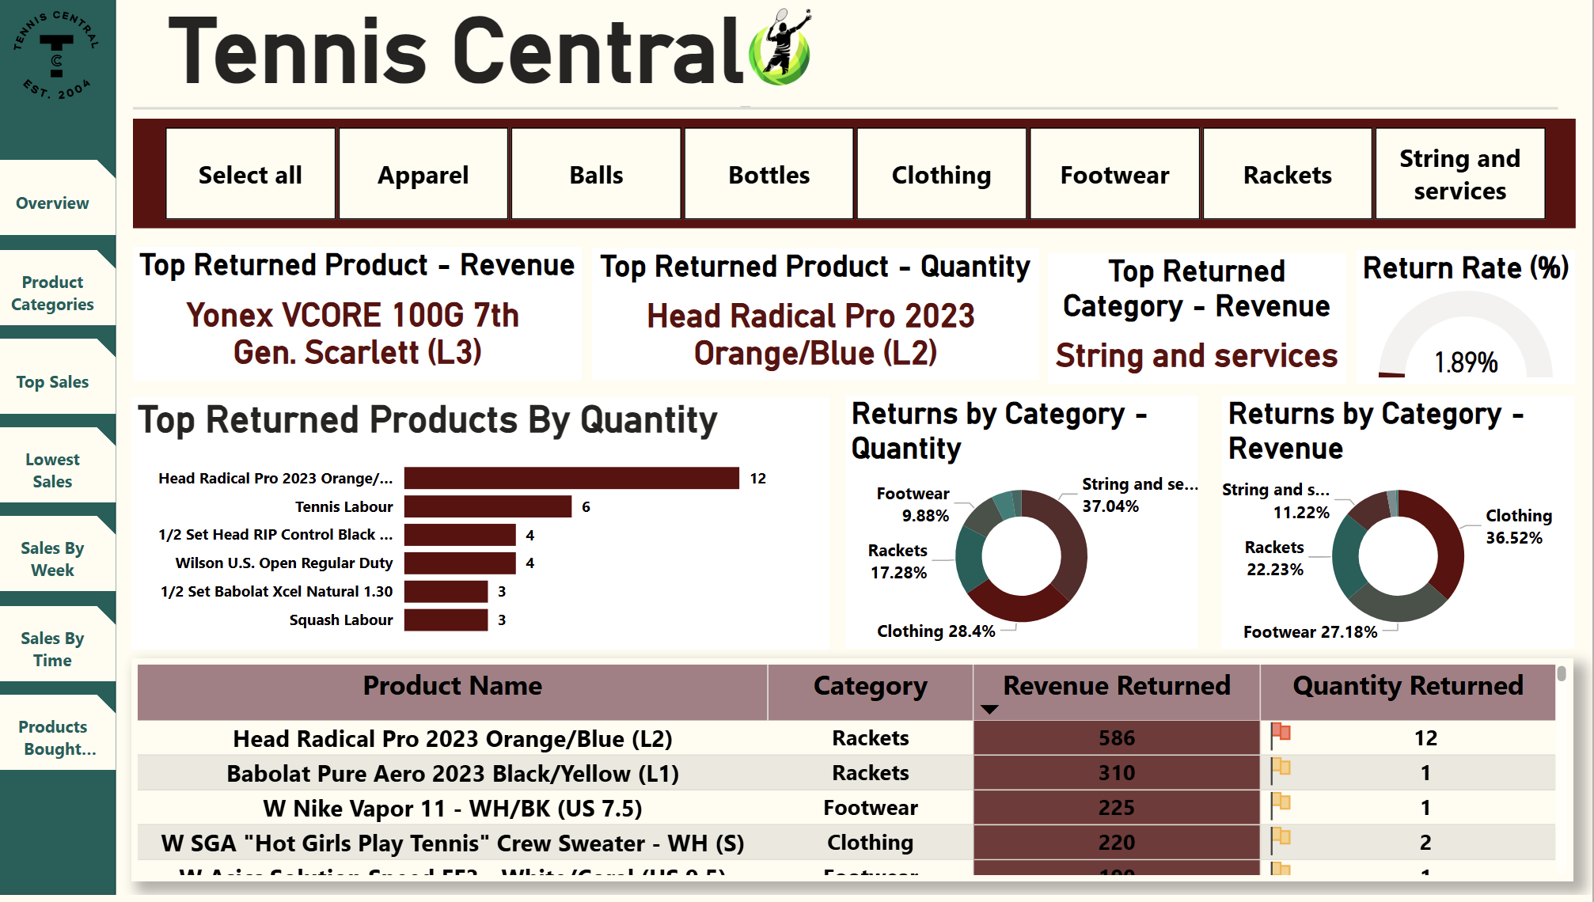
Top Product Returns:

Slide 18
Key Insights: Top Product Return
Highest Return by Quantity – Head Radical Pro 2023:
This racket model had the highest return volume with 12 units, indicating potential concerns related to product satisfaction, sizing, or performance.
Top Return by Revenue – Yonex VCORE 100G 7th Gen:
Accounted for the highest financial impact in returns, suggesting a need for closer evaluation of product expectations vs. customer experience.
Clothing and Stringing Services Drive Most Returns:
Clothing (36.52%) leads in return revenue, while String and Services (37.04%) tops return quantity, pointing to fit issues and potential service dissatisfaction.
Frequent Returns in Specific String Models:
Multiple stringing products (e.g., Babolat RPM, Head Velocity, Wilson Synthetic Gut) show single-unit returns, suggesting niche dissatisfaction or incorrect purchase selection.
Overall Return Rate is Low – 1.89%:
Indicates high customer satisfaction overall, with minimal returns relative to total transactions.

Slide 19
Answers to Analytical Questions
Clearly addressed critical business analytics questions:
Analytical Questions | Answer | Decision
1. What are the top categories? | String and Services (29.89% of total sales and 37.59% of quantity) is the top-performing category. Followed by Rackets (23.14%) and Clothing (15.61%). | Focus inventory and promotional strategies on high-performing categories like stringing services and rackets.
2. What are the top products in each category? | String and Services: Tennis Labour Rackets: Head Radical Pro 2023 Balls: Wilson U.S. Open Regular Duty Strings: Wilson NXT Natural Clothing: Crew Sweaters and Apparel Kits | Prioritize these products for stocking, promotions, and staff recommendations.
3. What are the lower product sales in each category? | ProPenn Regular Duty (lowest sales revenue) LOL Scrunchie White, Volant James Laces, Wilson RF Dampener 2-Pk (only 1 unit sold each) | Discontinue or heavily discount low-performing items to reduce deadstock and free up shelf space.

Slide 20
Answers to Analytical Questions
Analytical Questions | Answer | Decision
4. Which days of the week will have more sales? | Friday (749 units) and Monday ($19.9K revenue) are the top-performing days. Weekdays contribute to 72.63% of all sales. | Schedule more staff and promotions on Fridays and Mondays; focus resources on weekdays.
5. What are the peak sales hours of a day? | Morning is the most profitable time slot with $72.1K in sales and highest average transaction value ($52). Afternoon follows with good volume but lower average spend. | Ensure adequate staff availability and fresh inventory during morning hours for optimal customer experience.
6. What are the items that are bought frequently together? | Top product pair: Head Radical Pro 2023 + Tennis Labour (162 times). Others: Tennis Labour + Wilson NXT Natural Strings, Wilson Regular + Extra Duty Balls. | Introduce bundled offers or combo discounts on commonly paired products to increase average basket size.
7. What are the top products that have been returned? | By Quantity: Head Radical Pro 2023 (12 units). By Revenue: Yonex VCORE 100G (Highest dollar value returned). Categories with most returns: Clothing (36.52% by revenue) and String and Services (37.04% by quantity). | Investigate product sizing, quality, and service delivery. Improve product descriptions or trial options to reduce returns.

Slide 21


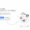


Implementation & Future Optimization
Data-Driven Inventory Planning:
Customer Satisfaction & Quality Control:
Identified best- and worst-performing products and categories.
Allowed for informed stocking decisions to minimize stockouts and reduce excess inventory.
Return analysis revealed issues with specific products and categories.
Actionable input for quality improvement and enhanced customer service.
Operational Efficiency:
Seamless Technical Integration:
Weekly and hourly sales analysis provided insights into peak traffic times.
Enabled smarter staff scheduling and store layout planning.
Built using CSV exports from Lightspeed and Shopify.
Cleaned in Python and visualized through a custom Power BI star schema model with advanced DAX measures.
Targeted Promotions & Bundling:
Product pairing insights allowed the business to design bundled offers (e.g., racket + labour).
Seasonal and weekly trends guide the timing of discounts and marketing efforts.

Slide 22






Conclusion & Business Impact
Strategic Decision-Making
Data-driven insights for new store setup
Operational Excellence
Optimized inventory, staffing, and store layout
Financial Performance
Increased sales and reduced costs
The Power BI solution empowered Tennis Central with actionable insights to support the launch of its new store. By identifying top-selling products, peak sales periods, and return trends, the team enabled data-driven decisions in inventory planning, staffing, and promotions. The dashboards provide a scalable, integrated, and user-friendly platform that enhances operational efficiency and supports future growth.

